Slide 1
UPE Tutoring:
CS 32 Project 3 Hack
Sign-in https://bit.ly/CS32-Proj3Signin-S19
Slides link available upon sign-in

Slide 2
Overview of Project

Slide 3
Overview
Implement Kalah (or Mancala?)
Two Player Game - One Human and One Computer
Implement the game
Obtain user input and progress through game
Implement the Computer Player
Different levels of AI
Not smart AI - picks a move randomly
Smart AI - considers moves, countermoves, determines which is best

Slide 4
Overview
Various Game Objects:
Board
Player (abstract base class for different types of players)
HumanPlayer
BadPlayer
SmartPlayer
Game

Slide 5
Project Structure
Various Files to Implement:
Board.h, Board.cpp
Board class manages holes, pots, beans, etc.
Player.h, Player.cpp
Contains the Player, HumanPlayer, BadPlayer, SmartPlayer classes
Game.h, Game.cpp
Game class created from a board and two players (human + bad, bad + smart, bad + bad, etc.)
Side.h
enums, constants, an inline function (look at the spec)

Slide 6
Project Structure
Main.cpp: (sample from spec)
int main()
{
HumanPlayer hp("Marge");
BadPlayer bp("Homer");
Board b(3, 2);
Game g(b, &hp, &bp);
g.play();
}

Slide 7
SmartPlayer

Slide 8
Crash Course on AI
AI is just part of your program
Write a program to…
Determine which moves are allowed, and what the resulting game state would be
Recognize when the game is over
Evaluate the state of the game and how desirable it is for a player
Determine what the best move is because it has the most desirable outcome

Slide 9
Concepts of the Implementation
Determine which moves are allowed, and what the resulting game state would be
Which moves are allowed?
Any pot with beans in it on the player’s side - easy
What is the resulting game state?
Also pretty easy - just pretend like you are doing the move and capture the resulting board state
Recognize when the game is over?
Pretty easy as well?
When either side of the board has no more beans (no more possible moves)

Slide 10
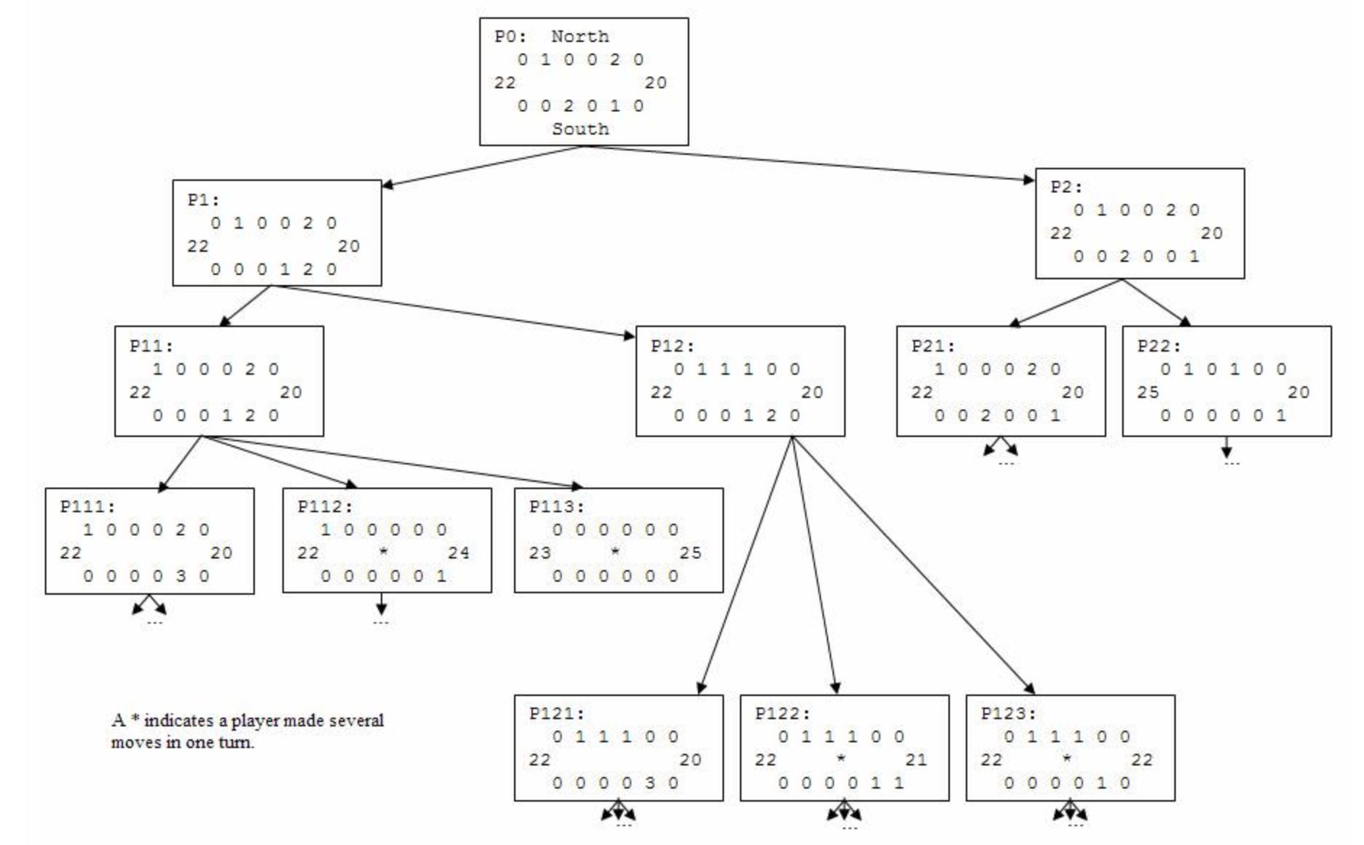
Game Trees

Slide 11
Concepts of the Implementation
Evaluate the state of the game and how desirable it is for a player
Determine what the best move is because it has the most desirable outcome
This one is harder...

Slide 12
Heuristics
Rule of thumb that explains how to evaluate the board
How good is this board for me?
Example heuristics:
“The more beans I have in my pot, the better”
int f1(Board b) {
return b.num_beans_in_my_pot();
}
“The greater the difference between my pot and the number, the better”
int f2(Board b) {
return b.num_beans_in_my_pot() - b.num_beans_in_opp_pot();
}

Slide 13
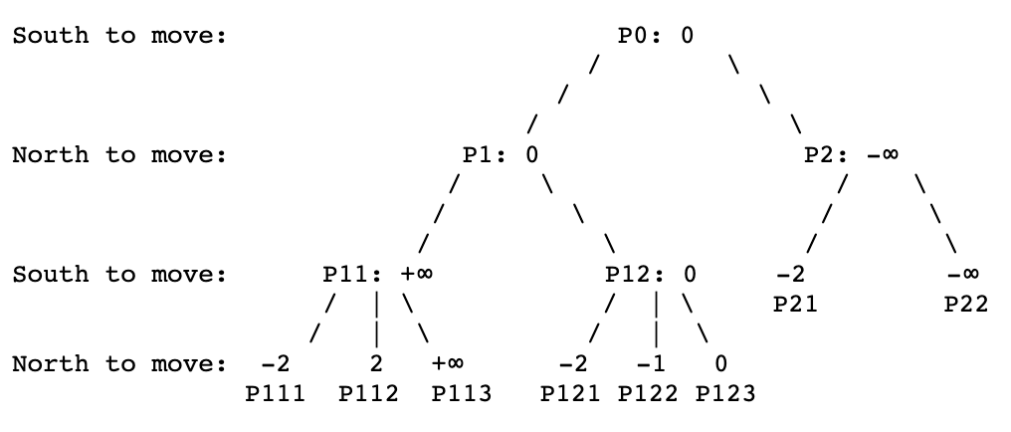
Minimax Algorithm
Assume both players are going to make the best move for them (you go first, then other player goes)
We want a move that helps us the most, and also prevents the other from making a good move
Max
We are the South Player
Numeric Values represent the difference in score
Value at node = South Pot’s beans minus North Pot’s beans
+∞ means we win
-∞ means we lose
Min
Max
Min

Slide 14
Miscellaneous Topics and Tips

Slide 15
Time
Currently, no posted way to do the 5 second cutoff for SmartPlayer?
For now, just limit the size of the search tree
Smallberg may post something in the Project 3 FAQ or update the spec at a later time

Slide 16
Compilation
Compilation - Release Mode vs. Debug Mode
On cs32.seas.ucla.edu, build w/ their compiler
$ g32fast -o kalah Main.cpp Board.cpp Player.cpp Game.cpp
$ ./kalah
Xcode and Visual C++
walkthrough for this mode is available at the bottom of the spec
Release mode is faster than Debug mode (but appropriately harder to debug because of optimizations)

Slide 17
Miscellaneous Tips
Start early!!
Compile and test your code often so you’re never overwhelmed by bugs
Make backups of your code
Tackle each feature one at a time
As thorough as the spec is, you still may have questions about implementation and game logic. The example programs on the website are great references for what should be done
Don’t procrastinate!! This is a long project!!
START EARLY!!

Slide 18
Good luck!
Sign-in http://bit.ly/CS32-Proj3Signin-S19
Slides http://bit.ly/CS32-Proj3Slides-S19
Practice https://github.com/uclaupe-tutoring/practice-problems/wiki
Questions? Need more help?
Come up and ask us! We'll try our best.
UPE offers daily computer science tutoring:
Location: ACM/UPE Clubhouse (Boelter 2763)
Schedule: https://upe.seas.ucla.edu/tutoring/
You can also post on the Facebook event page.

